Slide 1
PL/SQL BASICS
DBMS LAB – CS593

Slide 2
INTRODUCTION
PL/SQL is a combination of SQL along with the procedural features of programming languages.
It was developed by Oracle Corporation in the early 90's to enhance the capabilities of SQL.
PL/SQL is one of three key programming languages embedded in the Oracle Database, along with SQL itself and Java.
PL/SQL is a completely portable, high-performance transaction-processing language.
Apart from Oracle, PL/SQL is available in TimesTen in-memory database and IBM DB2.

Slide 3
Features of PL/SQL
PL/SQL is tightly integrated with SQL.
It offers extensive error checking.
It offers numerous data types.
It offers a variety of programming structures.
It supports structured programming through functions and procedures.
It supports object-oriented programming.
It supports the development of web applications and server pages.

Slide 4
Advantages of PL/SQL
SQL is the standard database language and PL/SQL is strongly integrated with SQL. PL/SQL supports both static and dynamic SQL. Static SQL supports DML operations and transaction control from PL/SQL block. In Dynamic SQL, SQL allows embedding DDL statements in PL/SQL blocks.
PL/SQL allows sending an entire block of statements to the database at one time. This reduces network traffic and provides high performance for the applications.
PL/SQL gives high productivity to programmers as it can query, transform, and update data in a database.
PL/SQL saves time on design and debugging by strong features, such as exception handling, encapsulation, data hiding, and object-oriented data types.
Applications written in PL/SQL are fully portable.
PL/SQL provides high security level.
PL/SQL provides access to predefined SQL packages.
PL/SQL provides support for Object-Oriented Programming.
PL/SQL provides support for developing Web Applications and Server Pages.

Slide 5
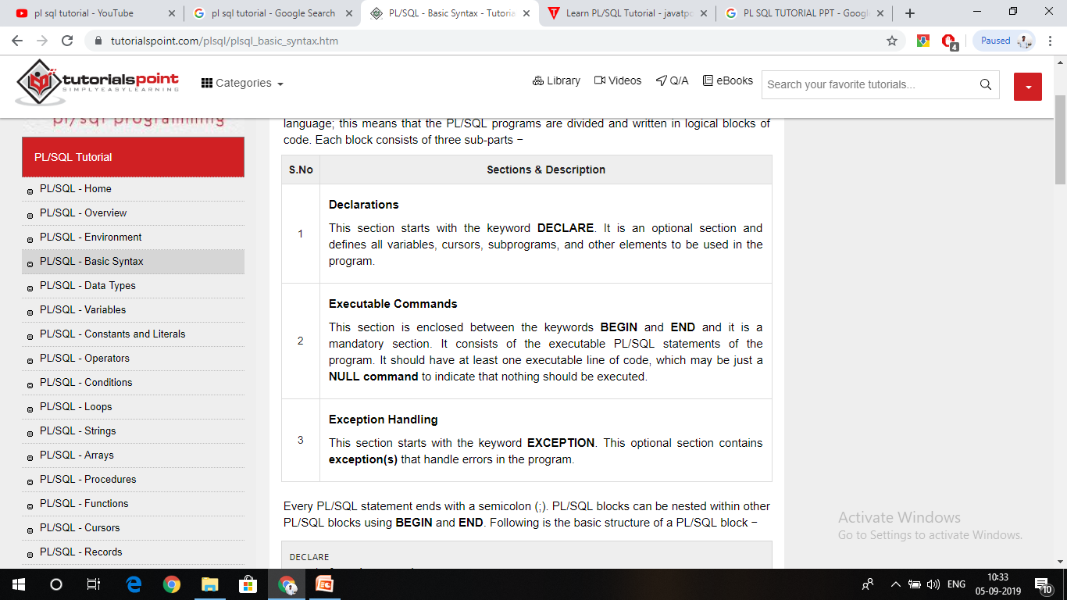
PL/SQL - Basic Syntax
PL/SQL is a block-structured language. PL/SQL programs are divided and written in logical blocks of code. Each block consists of three sub-parts −

Slide 6
Every PL/SQL statement ends with a semicolon (;). PL/SQL blocks can be nested within other PL/SQL blocks using BEGIN and END. Following is the basic structure of a PL/SQL block
DECLARE
<declarations section>
BEGIN
<executable command(s)>
EXCEPTION
<exception handling>
END;

Slide 7
1st Example : Printing “Hello World”
DECLARE
message varchar2(20):= 'Hello, World!';
BEGIN
dbms_output.put_line(message);
END;

Slide 8
The PL/SQL Identifiers
PL/SQL identifiers are constants, variables, exceptions, procedures, cursors, and reserved words. The identifiers consist of a letter optionally followed by more letters, numerals, dollar signs, underscores, and number signs and should not exceed 30 characters.
By default, identifiers are not case-sensitive. So you can use integer or INTEGER to represent a numeric value. You cannot use a reserved keyword as an identifier.

Slide 9
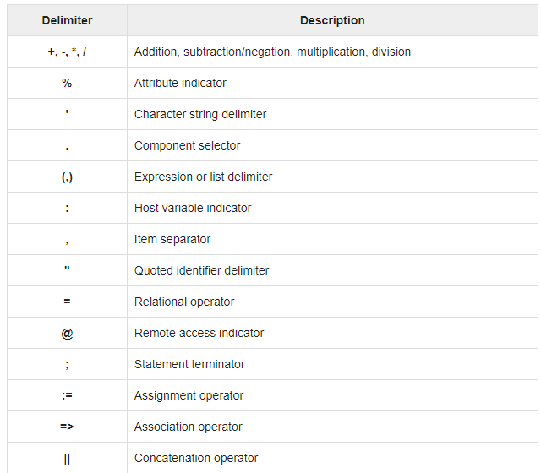
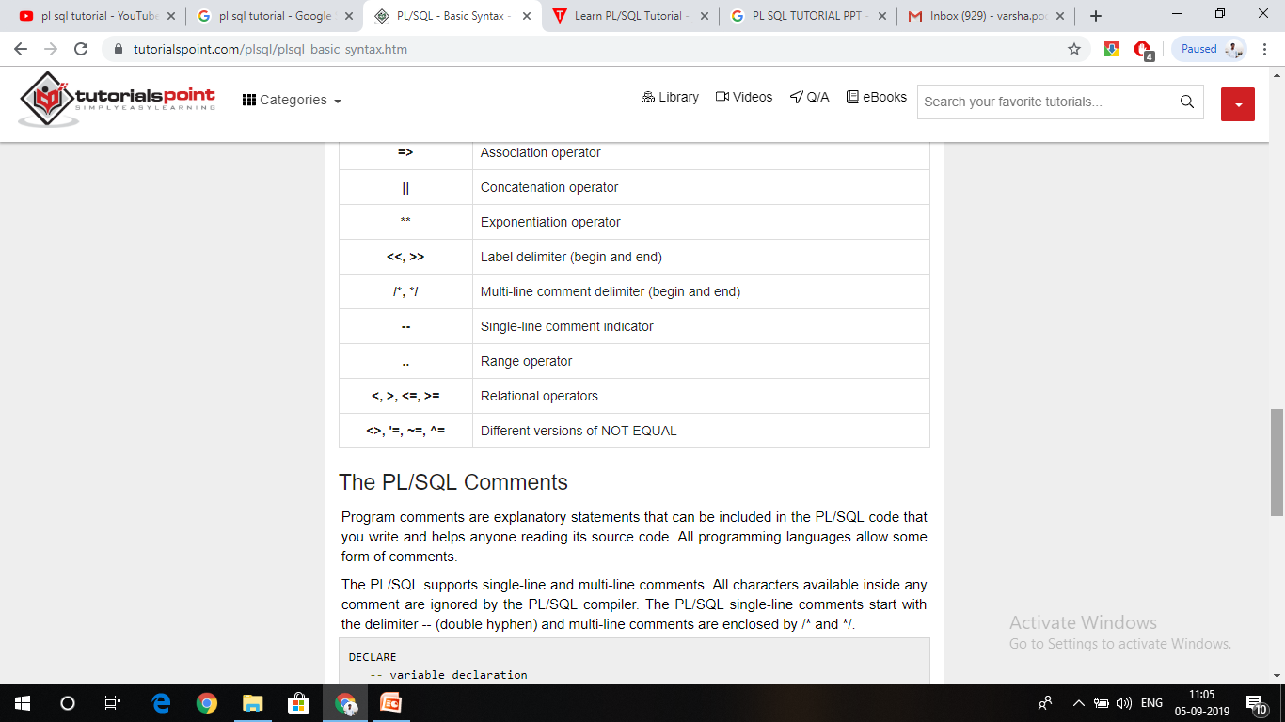
The PL/SQL Delimiters

Slide 10
The PL/SQL Comments
DECLARE -- variable declaration message varchar2(20):= 'Hello, World!';
BEGIN
/*
PL/SQL executable statement(s)
*/ dbms_output.put_line(message);
END;
Output-
Hello World
PL/SQL procedure successfully completed.

Slide 11
PL/SQL Program Units
A PL/SQL unit is any one of the following −
PL/SQL block
Function
Package
Package body
Procedure
Trigger
Type
Type body

Slide 12
PL/SQL - Data Types
1. Scalar: Single values with no internal components, such as a NUMBER, DATE, or BOOLEAN.
2. Large Object (LOB): Pointers to large objects that are stored separately from other data items, such as text, graphic images, video clips, and sound waveforms.
3. Composite: Data items that have internal components that can be accessed individually. For example, collections and records.
4. Reference: Pointers to other data items.

Slide 13
PL/SQL Scalar Data Types and Subtypes-
Numeric: Numeric values on which arithmetic operations are performed.
Character: Alphanumeric values that represent single characters or strings of characters.
Boolean: Logical values on which logical operations are performed.
Datetime: Dates and times.

Slide 14
PL/SQL - Variables
The syntax for declaring a variable is −
variable_name [CONSTANT] datatype [NOT NULL] [:= DEFAULT initial_value]
Some valid variable declarations along with their definition are shown below −
sales number(10, 2);
pi CONSTANT double precision := 3.1415;
name varchar2(25);
address varchar2(100);

Slide 15
Initializing Variables in PL/SQL
Whenever you declare a variable, PL/SQL assigns it a default value of NULL. If you want to initialize a variable with a value other than the NULL value, you can do so during the declaration, using either of the following −
The DEFAULT keyword
The assignment operator
For example −
counter binary_integer := 0; greetings varchar2(20) DEFAULT 'Have a Good Day';

Slide 16
An Example
DECLARE
a integer := 10;
b integer := 20;
c integer;
f real;
BEGIN
c := a + b;
dbms_output.put_line('Value of c: ' || c);
f := 70.0/3.0;
dbms_output.put_line('Value of f: ' || f);
END;
/
Output-
Value of c: 30 Value of f: 23.333333333333333333

Slide 17
Variable Scope in PL/SQL
PL/SQL allows the nesting of blocks, i.e., each program block may contain another inner block. If a variable is declared within an inner block, it is not accessible to the outer block. However, if a variable is declared and accessible to an outer block, it is also accessible to all nested inner blocks. There are two types of variable scope −
Local variables − Variables declared in an inner block and not accessible to outer blocks.
Global variables − Variables declared in the outermost block or a package.

Slide 18
Following example shows the usage of Local and Global variables in its simple form −
DECLARE
-- Global variables
num1 number := 95;
num2 number := 85; BEGIN dbms_output.put_line('Outer Variable num1: ' || num1);
dbms_output.put_line('Outer Variable num2: ' || num2);
DECLARE
-- Local variables
num1 number := 195;
num2 number := 185;
BEGIN dbms_output.put_line('Inner Variable num1: ' || num1); dbms_output.put_line('Inner Variable num2: ' || num2);
END;
END;
/

Slide 19
PL/SQL - Operators
PL/SQL language is rich in built-in operators and provides the following types of operators −
Arithmetic operators (+, -, *, / etc.)
Relational operators (=, !=, <>, <, >, <=, >= etc.)
Comparison operators (LIKE, BETWEEN, IS NULL, IN)
Logical operators (and, or, not)
String operators (will be discussed later)

Slide 20
PL/ SQL Conditional statements
PL/SQL programming language provides following types of decision-making statements:
-IF-THEN statement
-IF-THEN-ELSE statement
-IF-THEN-ELSIF statement
-CASE statement
-Searched CASE state
-Nested IF-THEN-ELSE statement

Slide 21
PL/SQL - Loops
-BASIC Loop
-WHILE Loop
-FOR Loop
-Nested Loops

Slide 22
The following program illustrates the concept −
DECLARE
i number(1);
j number(1);
BEGIN
<< outer_loop >>
FOR i IN 1..3 LOOP
<< inner_loop >>
FOR j IN 1..3 LOOP
dbms_output.put_line('i is: '|| i || ' and j is: ' || j);
END loop inner_loop;
END loop outer_loop;
END;
/

Slide 23
The Loop Control Statements
EXIT statement: The Exit statement completes the loop and control passes to the statement immediately after the END LOOP.
CONTINUE statement: Causes the loop to skip the remainder of its body and immediately retest its condition prior to reiterating.
GOTO statement: Transfers control to the labeled statement. Though it is not advised to use the GOTO statement in your program.

Slide 24
PL/SQL - Strings
PL/SQL offers three kinds of strings −
Fixed-length strings − In such strings, programmers specify the length while declaring the string. The string is right-padded with spaces to the length so specified.
Variable-length strings − In such strings, a maximum length up to 32,767, for the string is specified and no padding takes place.
Character large objects (CLOBs) − These are variable-length strings that can be up to 128 terabytes.

Slide 25
Declaring String Variables
DECLARE
name varchar2(20);
company varchar2(30);
introduction clob; choice char(1);
BEGIN
name := 'John Smith';
company := 'Infotech';
introduction := ' Hello! I''m John Smith from Infotech.';
choice := 'y';
IF choice = 'y'
THEN
dbms_output.put_line(name);
dbms_output.put_line(company);
dbms_output.put_line(introduction);
END IF;
END;
/

Slide 26
PL/SQL String Functions and Operators
CHR(x); Returns the character with the ASCII value of x.
CONCAT(x, y); Concatenates the strings x and y and returns the appended string.
INSTR(x, find_string [, start] [, occurrence]);
Searches for find_string in x and returns the position at which it occurs.
4. INSTRB(x); Returns the location of a string within another string, but returns the value in bytes.
5. LENGTH(x); Returns the number of characters in x.
6. LENGTHB(x); Returns the length of a character string in bytes for single byte character set.
7. LOWER(x); Converts the letters in x to lowercase and returns that string.
8. LPAD(x, width [, pad_string]) ; Pads x with spaces to the left, to bring the total length of the string up to width characters.
9. LTRIM(x [, trim_string]); Trims characters from the left of x.
10. NANVL(x, value); Returns value if x matches the NaN special value (not a number), otherwise x is returned.

Slide 27
11. REPLACE(x, search_string, replace_string);
Searches x for search_string and replaces it with replace_string.
12. RPAD(x, width [, pad_string]); Pads x to the right.
13. RTRIM(x [, trim_string]); Trims x from the right.
14. SUBSTR(x, start [, length]); Returns a substring of x that begins at the position specified by start. An optional length for the substring may be supplied.
15. UPPER(x); Converts the letters in x to uppercase and returns that string.

Slide 28
A program with string functions Example
DECLARE
greetings varchar2(11) := 'hello world';
BEGIN
dbms_output.put_line(UPPER(greetings));
dbms_output.put_line(LOWER(greetings));
dbms_output.put_line(INITCAP(greetings));
/* retrieve the first character in the string */
dbms_output.put_line ( SUBSTR (greetings, 1, 1));
/* retrieve the last character in the string */
dbms_output.put_line ( SUBSTR (greetings, -1, 1));
/* retrieve five characters, starting from the seventh position. */ dbms_output.put_line ( SUBSTR (greetings, 7, 5));
/* retrieve the remainder of the string, starting from the second position.*/
dbms_output.put_line ( SUBSTR (greetings, 2));
/* find the location of the first "e" */
dbms_output.put_line ( INSTR (greetings, 'e'));
END;
/

Slide 29
PL/SQL - Arrays
VARRAY, which can store a fixed-size sequential collection of elements of the same type.
The basic syntax for creating a VARRAY type at the schema level is −
CREATE OR REPLACE TYPE varray_type_name IS VARRAY(n) of <element_type>
Where,
varray_type_name is a valid attribute name,
n is the number of elements (maximum) in the varray,
element_type is the data type of the elements of the array.

